Slide 1


Funder Communication

Slide 2


Desired Outcomes for Successful Funder Communication
Steps to Develop a Funder Communication Plan
Methods of Funder Communication
Today’s Agenda
Notes:
Paul

Slide 3
Creating a strong network of funders who are committed to your mission and vision is essential to sustaining the work and impact of any nonprofit organization.
Outcomes of Successful Funder Communication
Notes:
Paul

Slide 4
Outcomes of successful funder communication:
Attracting their attention
Building trust and credibility
Building knowledge and understanding about your work, impact and relevance
Outcomes of Successful Funder Communication
cont.
Notes:
Paul

Slide 5
Funder communication is more than just communication —
It’s about building a relationship
Making a good first impression
Making it mutually beneficial
Investing time
Providing multiple touch-points
Two-way communication
Cultivating Relationships
Notes:
Paul
Two way communication: importance of communicating with funders during critical points in the work - whether something controversial is about to hit, you need the cover from the funder, national story (think JULIAN, baby formula shortage, controversial studies). Or you have really cool research/learnings that the foundation helped fund and might want to amplify.

Slide 6
Where do I begin? Do your homework!
Conduct research on the foundation’s funding priorities
  Who have they funded in the past?
  What do they care about?
  What issues have they worked on?
Be responsive
Demonstrate your expertise and impact
Steps to Develop a Funder Communication Plan
Notes:
Paul

Slide 7
The Kresge Foundation
The Kresge Foundation works strategically to find the intersections between eight programs and practices including environment, health, education, arts and culture, to expand opportunity in America’s cities. Kresge works deeply in places like Detroit, New Orleans and Memphis.
In 2020, the Kresge Foundation committed $9.2 million in grants to 26 frontline organizations confronting inequity, systems of exclusion and shaping community-driven solutions. Several grants to New Orleans-based organizations aim to build an ecology that supports small businesses owned by people of color through greater access to capital and targeted technical assistance.
Notes:
Paul

Slide 8
The Kresge Foundation cont.
Programs and practices for investment: American cities Arts and culture Detroit Education Environment Health Human services Social investment practice | Focus cities: Detroit: Kresge’s hometown has always been central to it’s work. Current efforts center on equity and neighborhood revitalization. Memphis: Kresge works with local leaders to translate lessons from Detroit to Memphis and advance equity. New Orleans: In New Orleans, Kresge seeks to expand urban opportunity and address climate change while advancing racial and economic equity.
Notes:
Paul

Slide 9
Steps to Develop a Funder Communication Plan
Put yourself in their shoes to understand where they are coming from. Like you, foundation staff have a job to do. They are driven by a mission and they want to make
an impact.
Learn about their goals and objectives
Learn about their values
Learn about what’s important to them
While you are seeking funding to support your objectives, the funder is considering what investments will help meet their own goals.
Consider how your programmatic work aligns with their objectives and values
Notes:
Paul

Slide 10
Steps to Develop a Funder Communication Plan cont.
Tailor your positioning and message to:
Issues of importance to the funder,
Populations of interest and priority,
Demonstrate urgency about the issue.
  Don’t assume that funders understand the circumstances of your issue.
Notes:
Paul

Slide 11

Steps to Develop a Funder Communication Plan
Go Beyond the Dollars
Consider other ways to engage foundations/funders who have more to offer than just dollars
Many funders have access to experts and have information on lessons learned/information
Funders can serve as “connectors” to introduce you to other valuable organizations, leaders and colleagues in their network
  Work with other partners in and across different sectors to help advance your mission
Notes:
Paul

Slide 12
Steps to Develop a Funder Communication Plan cont.
Be Reciprocal
Consider other ways to engage foundations/funders who have more to offer than just dollars
Consistently check in with program officers to find out what is top of mind for them
Share progress about your work (lessons learned, wins and impact)
Act as a resource to funders. Share local intel about the community or issue
Be thought partners to each other
Notes:
Paul

Slide 13
Methods of Funder Engagement

Slide 14
Your organization should deploy content through a series of core foundational communication tools to create a direct, distinct line of communication with potential funders and continue to sustain existing relationships.
Create Foundational Communication Tools for Funder Engagement
Notes:
Ujala

Slide 15
Methods of Communication:
Case studies about your work
Website
Testimonials from community members
Data and evaluation
Regular check-in’s by email, video or in-person
Share news clippings/articles
Create Foundational Communication Tools for Funder Engagement
cont.
Notes:
Ujala

Slide 16
Case studies
Case studies should:
Explain the problem
Articulate your approach/activities
Demonstrate impact
Highlight funders and how funding was used
Case studies set out the argument for supporting your cause — the argument should be straightforward, easy to understand and appeal to a wide range of stakeholders.
Notes:
Ujala

Slide 17
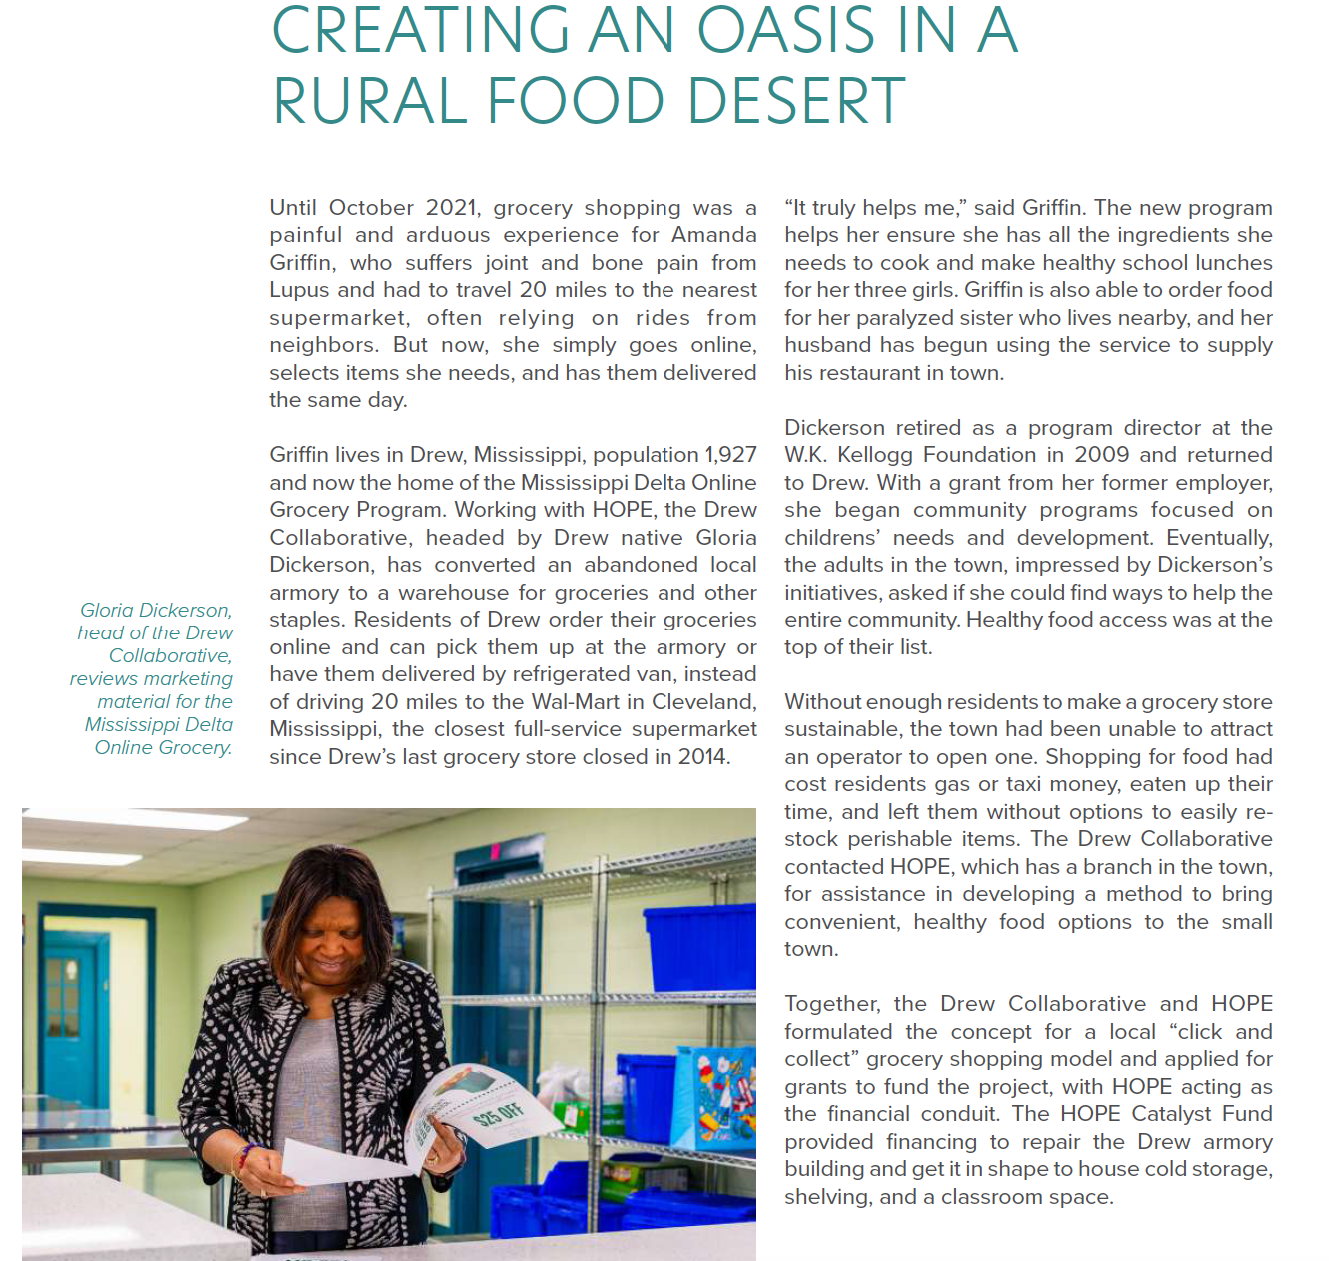
Case studies
When communicating with potential funders, you should use a case study to explain opportunities for advancement and how funders can engage deeply with your organization.
Notes:
Ujala

Slide 18
Funders want to know what your impact is. Data and evaluation are critical to demonstrating how well you are addressing the problems you are trying to solve, what you are learning and how you plan to use those learnings to improve your work to be as effective as possible.
Data and evaluation
Notes:
Ujala

Slide 19
Data and evaluation
cont.
Impact can be difficult to quantify, however, data helps funders make decisions based on facts. By collecting data and keeping track of results, you are making a case for why funders should support your work.
Notes:
Ujala

Slide 20
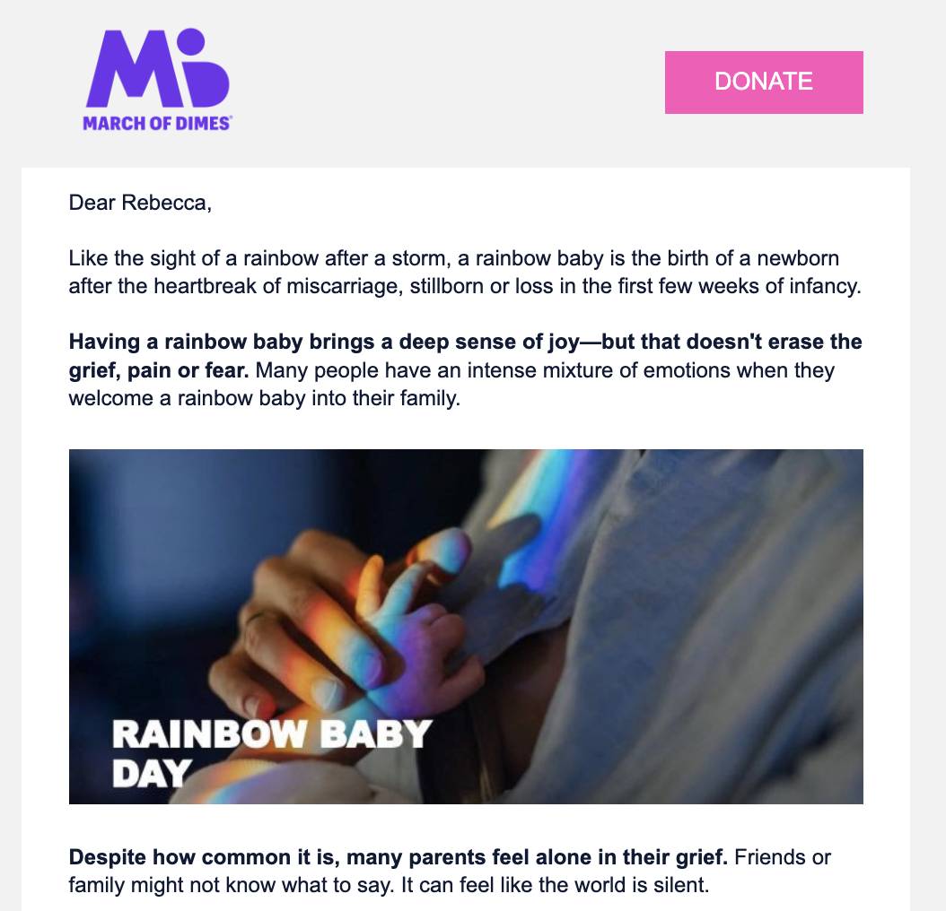
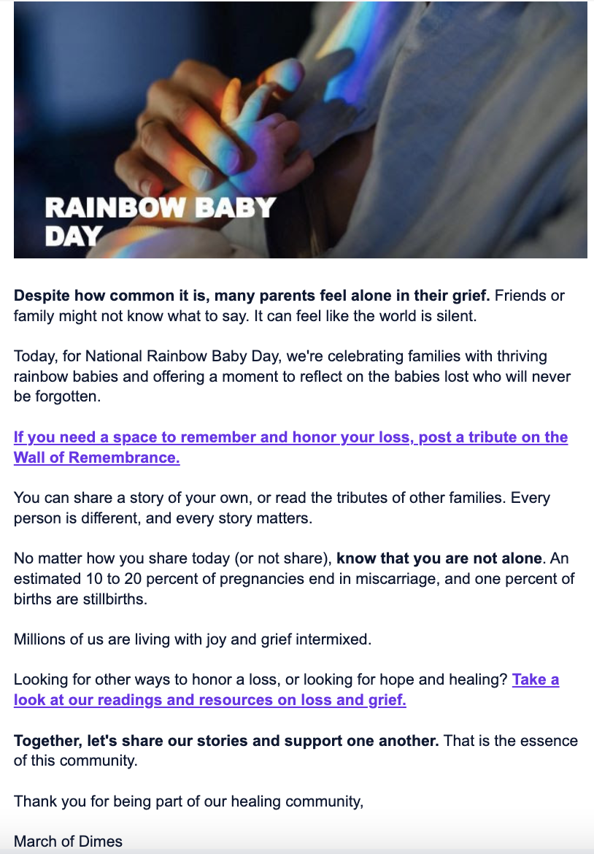
Data and evaluation cont.
Tools for collecting data
Storytelling: Collect stories from impacted people about how your services helped them or their community
Surveying: Ask targeted questions about your organization’s programs, campaigns or events to track progress and impact
Attendance sheets: Count the number of attendees at your organization’s events
Focus groups or interviews: Speak directly with community members you are trying to reach
Notes:
Ujala

Slide 21
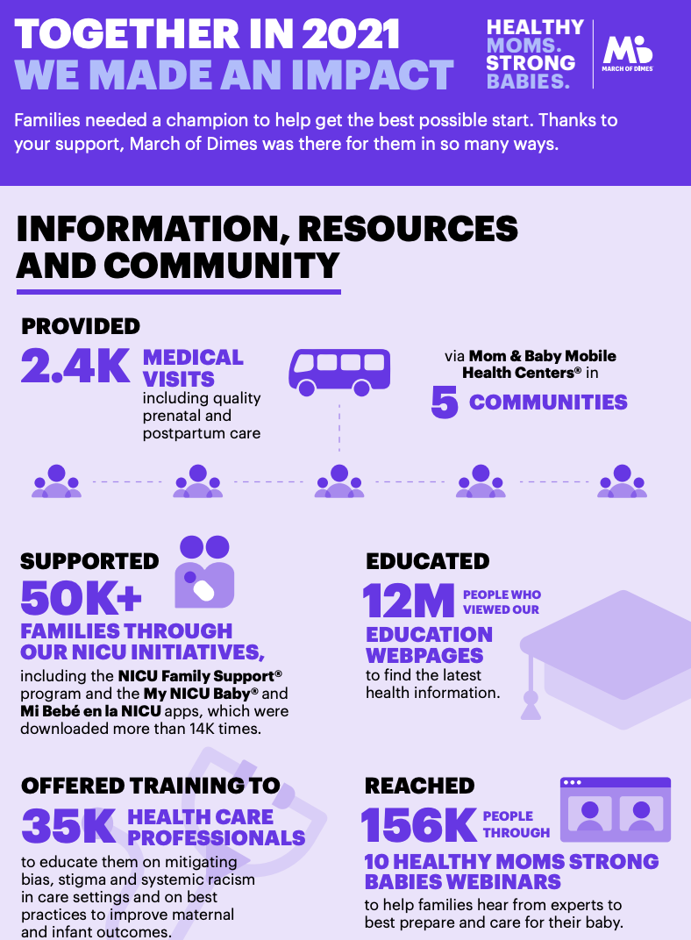
Data and evaluation cont.
Once you have collected your data, the next step is to determine how you will showcase it to funders. This can include:
Infographics
Impact reports
Earned media
Email and social media
Notes:
Ujala

Slide 22
For potential funders, testimonials can be incredibly valuable. They enable funders to hear directly from an impacted person, community member, volunteer, or staffer about how your organization’s work has benefited them or the community.
Testimonials
Notes:
Ujala

Slide 23
How to get testimonials:
Follow up regularly with impacted people, community members or volunteers and ask for feedback. Feedback can be collected through social media, Survey Monkey, or Google Forms
Encourage your network to record a short video about the work your organization is doing and their involvement in it
Create a “share your story” page that allows people to easily submit their stories
Testimonials
cont.
Notes:
Ujala

Slide 24
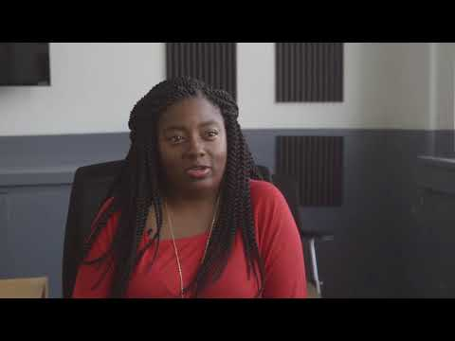

Testimonials
cont.
Notes:
Ujala

Slide 25
In addition to foundation funding, individual donations make up a large portion of a nonprofit’s overall fundraising stream. It is crucial to build relationships with donors and keep them informed of your work to encourage long term giving.
Methods for Donor Communication
Notes:
Ujala

Slide 26


Website
Your website is a chance to make a first impression with a prospective donor.
Draw the user’s eye to your main call-to-action. A clean design is important to allow your main call-to-action to stand out.
Consider adding special pages directed at funders/donors.
Notes:
Ujala

Slide 27
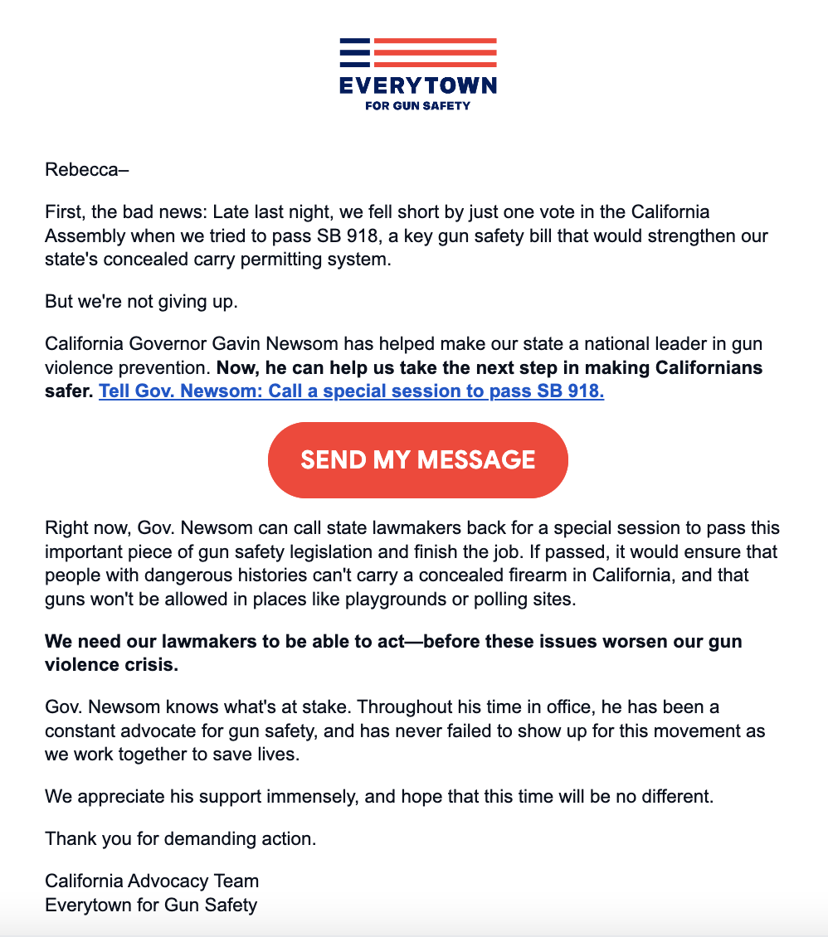
Email
Email is a critical component when it comes to digital fundraising.
Segment your list: It’s important to cater your email program toward different audiences so that you can maintain a healthy list by sending relevant information to your audiences. This also helps increase donor retention and allows you personalize your copy and ask.
Send fundraising emails: Fundraising starts with making the ask, therefore it’s important that you’re making that ask to your email list whenever possible.
Employ storytelling: Tell the stories of community members and impacted people.
Notes:
Ujala

Slide 28

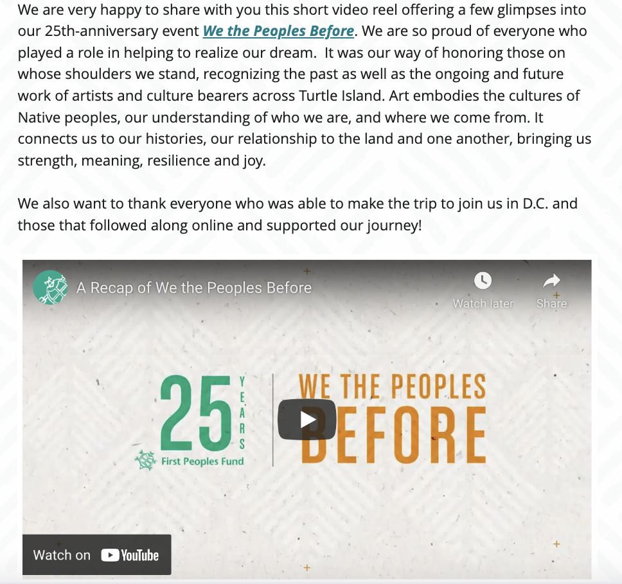
Email cont.
Demonstrate impact to donors over email: Don’t simply ask your list to donate, update them later with what you did with their gift whether it’s funding a specific project or program. Take the time to thank them and encourage them to either make bigger gifts or become a sustaining donor.
Use a single call-to-action: Your email should have one goal and therefore the ask to your audience should be one thing. If you want your reader to donate, ensure that the only ask in the email is for a donation and that the only links in the body of the email are to a fundraising page.
Notes:
Ujala

Slide 29
Email cont.
Track your emails: Digital strategy is as much of an art as it is a science. It’s critical to track essential email key performance indicators (KPIs) such as delivery rate, open rate, unsubscribe rate, click-through rate and conversion rate to understand the effectiveness of your emails and adjust accordingly.
Email open rate shows us the number of email recipients who opened the email. A low open rate could be due to an uninteresting subject line, out of date email addresses, impersonal or irrelevant content or emails are sent to the same lists too frequently.
Click through rate is the percentage of people who clicked on at least one link in your email. Few clicks means that your call-to-action is not strong or enticing, or you could be overwhelming people with multiple asks in the same email.
Unsubscribes refer to the people who remove their email from your list. Segmenting your list, personalizing your emails and spacing them out can help keep your unsubscribes low.
Notes:
Ujala

Slide 30
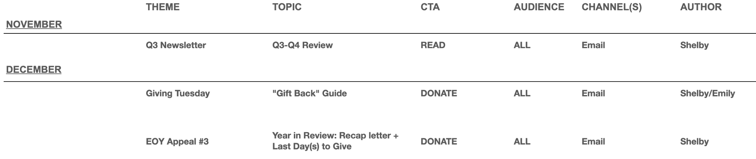
Email cont.
Be strategic:
Create an editorial calendar on either a monthly or biweekly basis to better plan emails, in order to not overwhelm your list.
Stick to a normal cadence of 3-4 emails a week.
Vary your senders in order to create a cast of characters to tell the story of your organization. This will help humanize your organization and create an authentic voice.
Capitalize on key moments such as Giving Tuesday or end of year giving.
Notes:
Ujala

Slide 31
It’s important that your email program is organized so that you’re not overwhelming your list with too many emails. If your list feels overwhelmed, they might not open your emails and decrease your open rate; they might report you as spam, which will then lead to your sends going to spam traps; or they’ll unsubscribe, filtering your emails into spam.
Email cont.
Notes:
Ujala

Slide 32
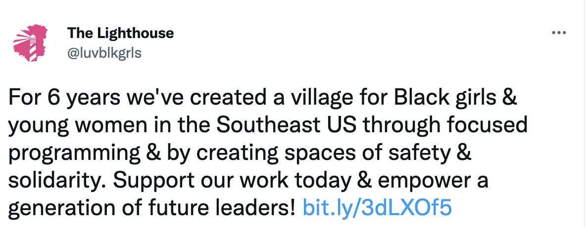

Social Media
Social channels are important for brand visibility as well as building an engaged digital community. While social media is not typically a main source of fundraising, it can help assist your cultivation and stewardship strategies.
Social media is also a key tool to stay engaged
with funders. Funders will share your work on their own channels, in email campaigns, annual reports and media interviews which provides additional visibility, credibility and can potentially attract other investments.
Your social media strategy should:
Include a posting schedule
Focus on building and maintaining relationships
Incorporate images and videos
Notes:
Ujala

Slide 33
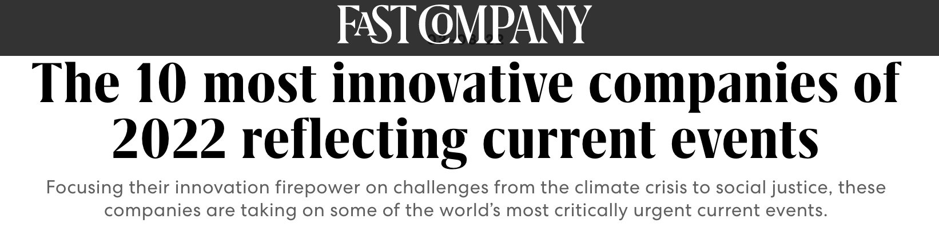
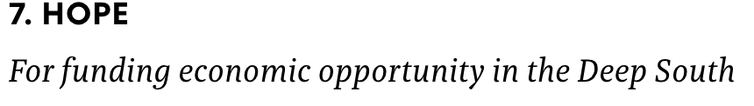
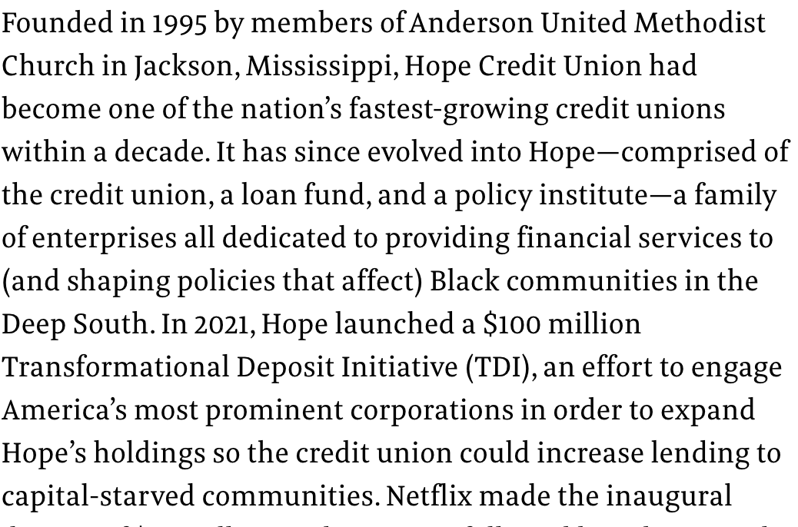
Engaging with Funders
Quality material development
Create touch points
Apply for awards to raise visibility
Notes:
Ed Sivak

Slide 34
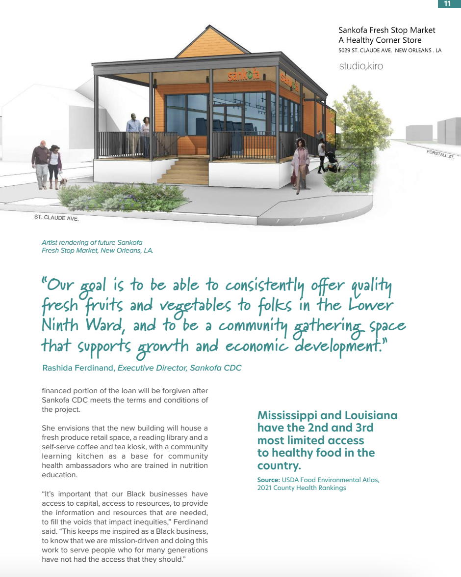
Engaging with Funders
The best messengers are often the people in the story we try to tell
Work networks to extend the story
Notes:
Ed Sivak

Slide 35

Thank You

